Slide 1
Network Architecture

Slide 2
Network Architecture
Network Architecture
Networks do not remain fixed at single point in time, but it must evolve to accommodate changes based on the technologies on which they are based and demands made by application programmer.
Network architecture guides the design and implementation of network. Two commonly used architecture are
OSI Architecture
Internet or TCP/IP architecture

Slide 3
Features of Layer Architecture
OSI Model
Layer architecture simplifies the network design.
It is easy to debug network applications in a layered architecture network.
The network management is easier due to the layered architecture.
Network layers follow a set of rules, called protocol.
The protocol defines the format of the data being exchanged, and the control and timing for the handshake between layers.
A protocol is a set of rules that governs data communication. It defines what is communicated, how it is communicated, and when it is communicated
It provides more modular design. To add some new service, it is enough to modify the functionality at one layer, reusing the functions provided at all the other layers

Slide 4
Open Systems Interconnection (OSI) Model
OSI Model
International standard organization (ISO) established a committee in 1977 to develop an architecture for computer communication.
Open Systems Interconnection (OSI) reference model is the result of this effort.
In 1984, the Open Systems Interconnection (OSI) reference model was approved as an international standard for communications architecture.
Term “open” denotes the ability to connect any two systems which conform to the reference model and associated standards.

Slide 5

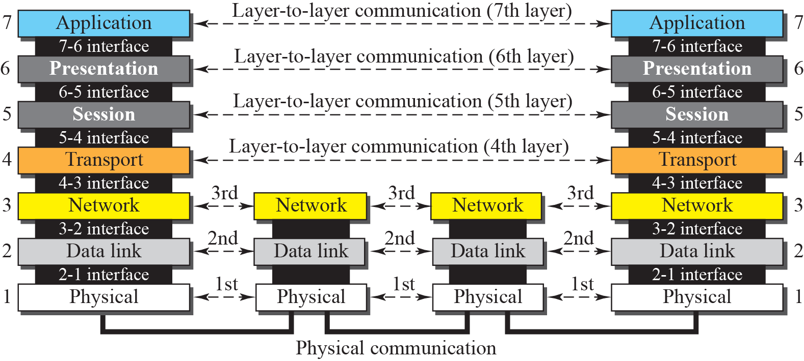
Interaction between layers in the OSI model

Slide 6
Description of Layers
Network Support Layers
Layers 1,2,3 - Physical, Data link and Network are the network support layers.
They deal with the physical aspects of moving data from one device to another such as electrical specifications, physical addressing, transport timing and reliability.
Transport Layer
Layer4, transport layer, ensures end-to-end reliable data transmission on a single link.
User Support Layers
Layers 5,6,7 – Session, presentation and application are the user support layers. They allow interoperability among unrelated software systems

Slide 7
Interaction between layers in the OSI model/Description of layers
Network Support Layers
Layers 1,2,3 - Physical, Data link and Network are the network support layers.
They deal with the physical aspects of moving data from one device to another such as electrical specifications, physical addressing, transport timing and reliability.
Transport Layer
Layer4, ensures end-to-end reliable data/message transmission on a single link.
User Support Layers
Layers 5,6,7 – Session, presentation and application are the user support layers. They allow interoperability among unrelated software systems

Slide 8
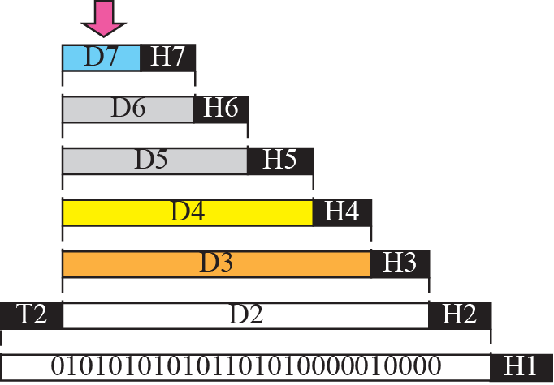


Figure An exchange using the OSI model

Slide 9
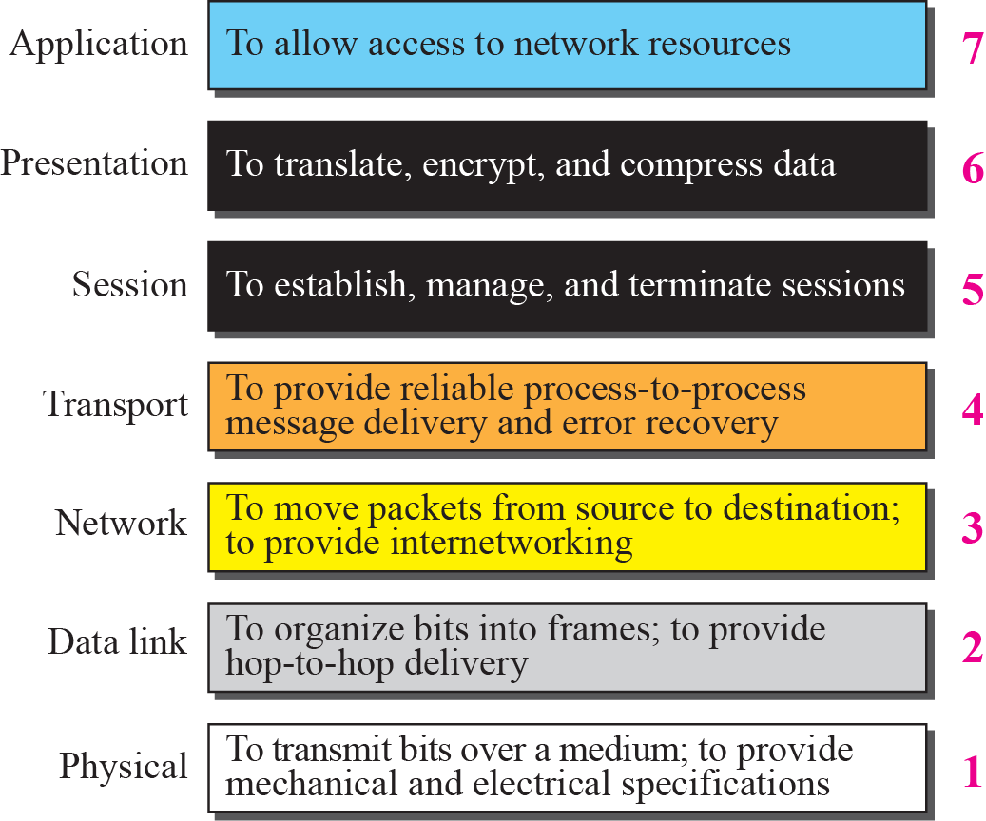
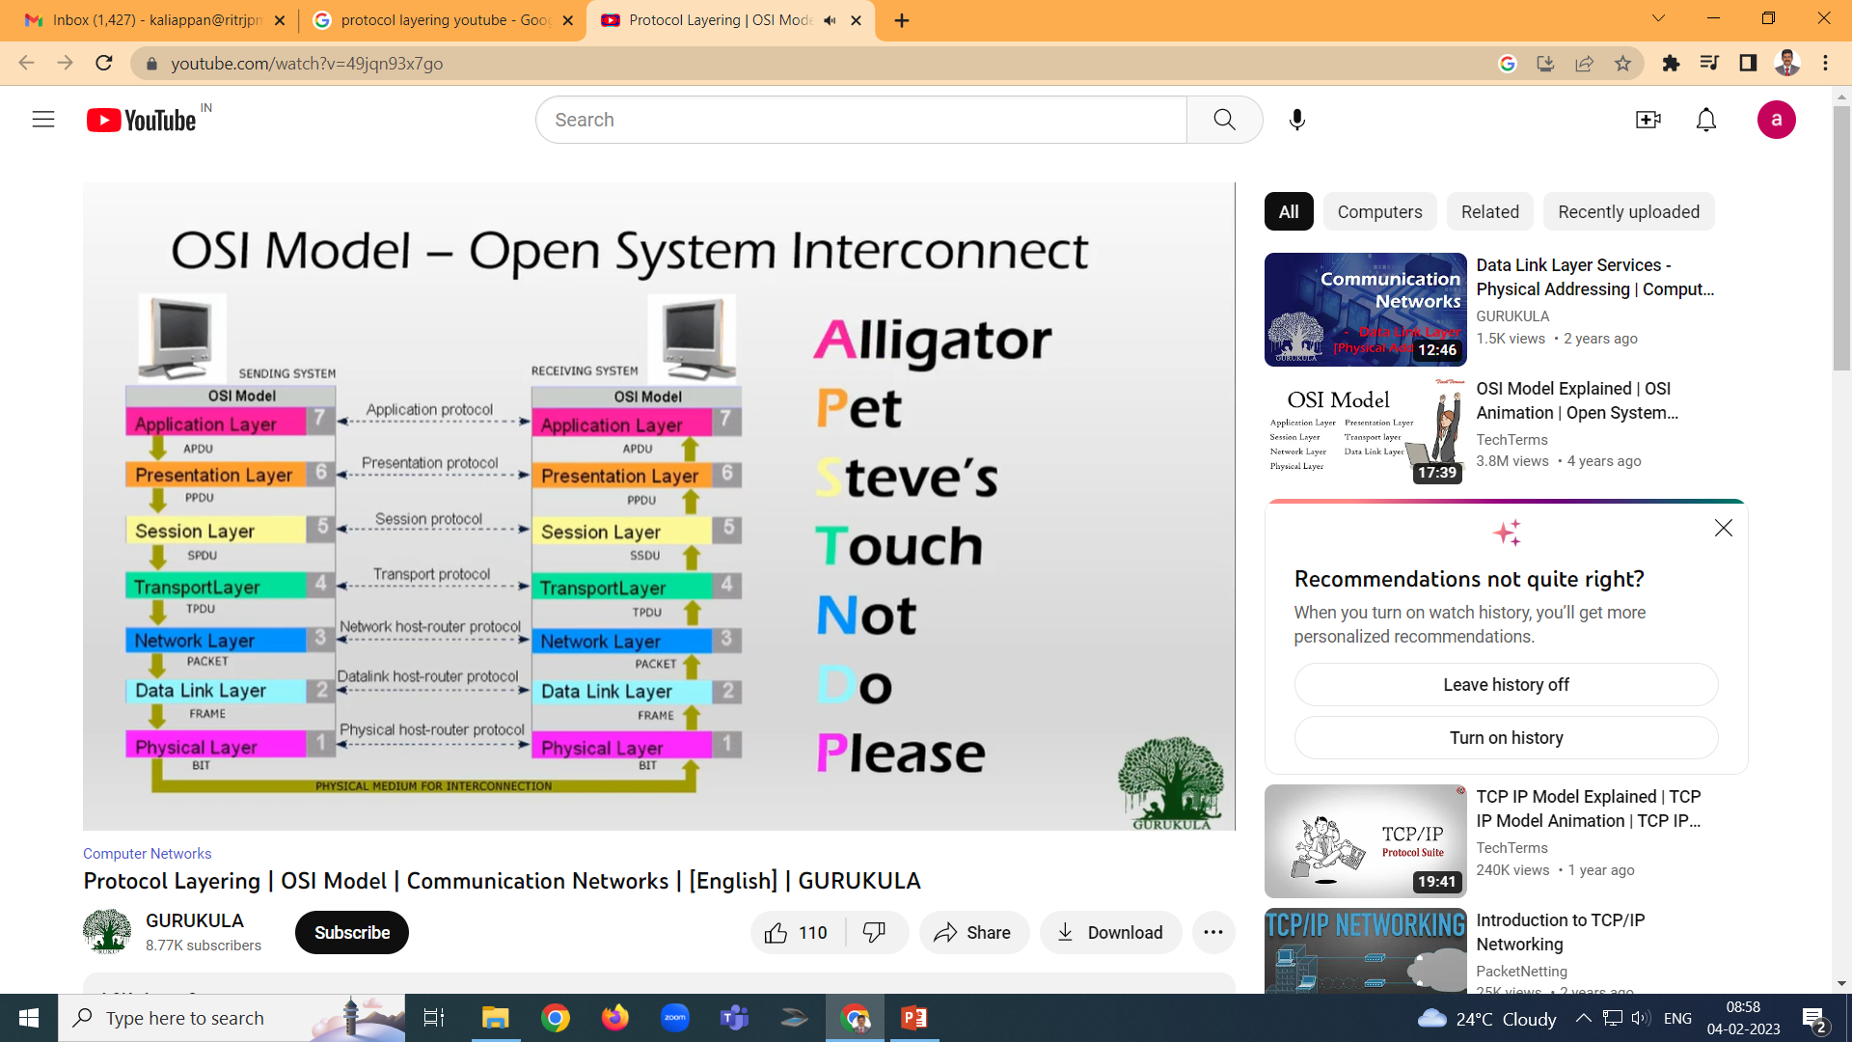
Summary of OSI Layers

Slide 10
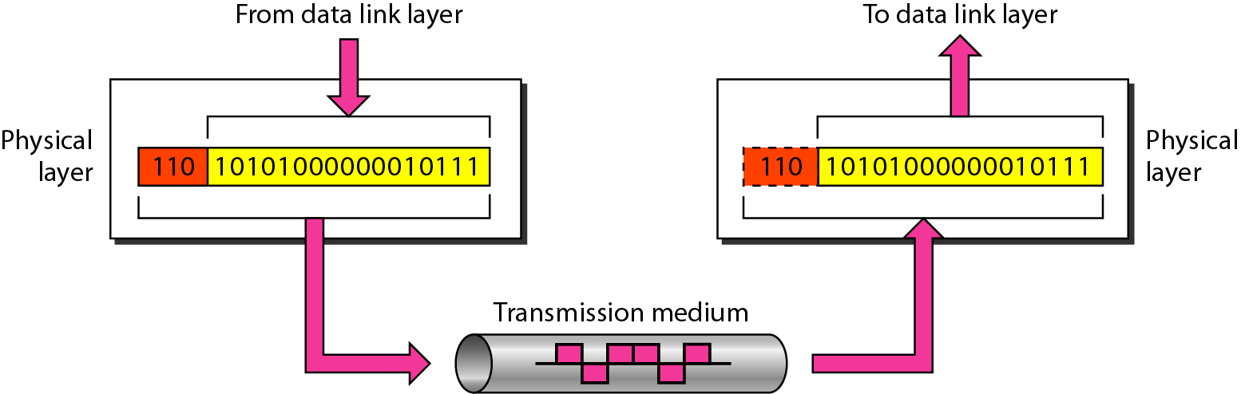
Physical layer
Physical characteristics of interfaces and media - The physical layer defines the characteristics of the interface between the devices and the transmission medium.
Representation of bits - To transmit the stream of bits, it must be encoded to signals. The physical layer defines the type of encoding.
Data Rate or Transmission rate - The number of bits sent each second – is also defined by the physical layer.
Synchronization of bits - The sender and receiver must be synchronized at the bit level. Their clocks must be synchronized.
Line Configuration - In a point-to-point configuration, two devices are connected together through a dedicated link. In a multipoint configuration, a link is shared between several devices.
Physical Topology - The physical topology defines how devices are connected to make a network. Devices can be connected using a mesh, bus, star or ring topology.
Transmission Mode - The physical layer also defines the direction of transmission between two devices: simplex, half-duplex or full-duplex.

Slide 11

Note
The physical layer is responsible for movements of
individual bits from one hop (node) to the next.

Slide 12
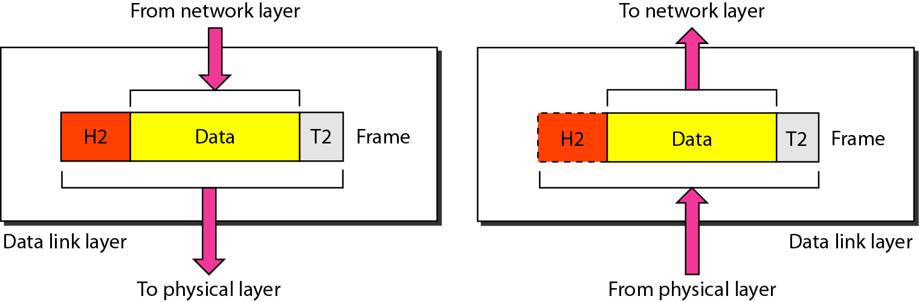
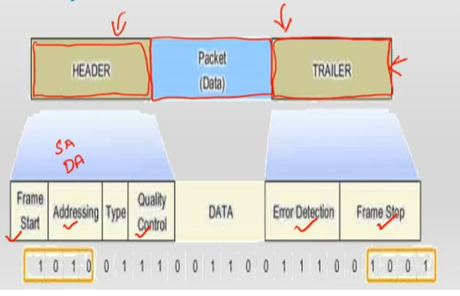
Data Link layer
It perform node to node packet delivery
Framing - Divides the stream of bits received into data units called frames.
Physical addressing – If frames are to be distributed to different systems on the n/w , data link layer adds the source address and destination address in the header to the frame to identify the sender and receiver.
Flow control- If the rate at which the data are absorbed by the receiver is less than the rate produced in the sender ,the Data link layer imposes a flow ctrl mechanism.
Error control- Used for detecting and retransmitting damaged or lost frames and to prevent duplication of frames. This is achieved through a trailer added at the end of the frame.
Access control -Used to determine which device has control over the link at any given time.

Slide 13
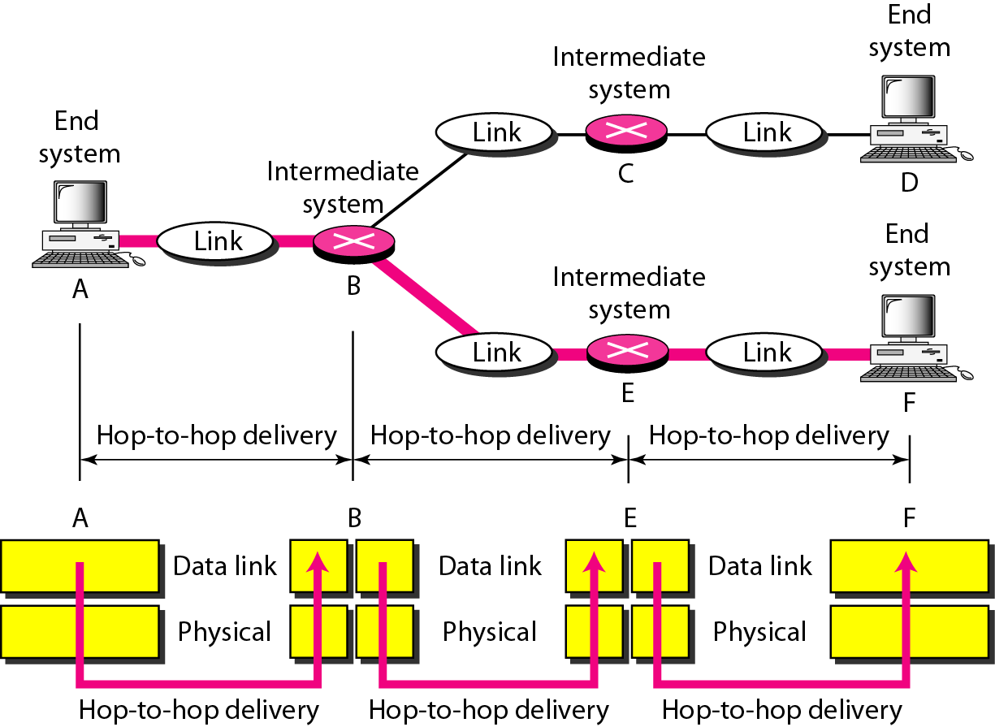
Figure node-to-node delivery
packets
packets
packets
packets
packets
packets
packets

Slide 14
Note
The data link layer is responsible for moving frames from one hop (node) to the next.

Slide 15
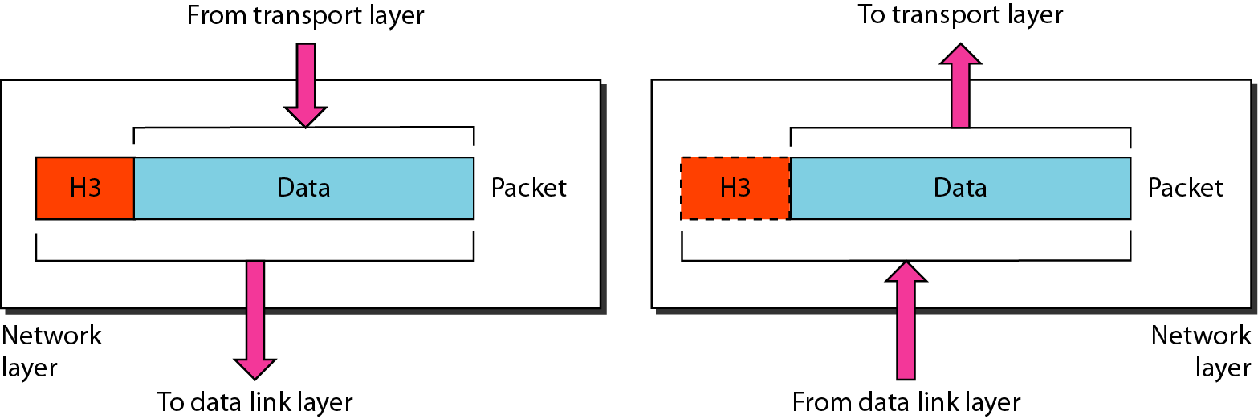
Network Layer
This layer is responsible for the delivery of packets from source to destination
Logical addressing - If a packet passes the n/w boundary, we need another addressing system for source and destination called logical address.
Routing – The devices which connects various networks called routers are responsible for delivering packets to final destination.

Slide 16
Note
The network layer is responsible for the delivery of individual packets from
the source host to the destination host.

Slide 17
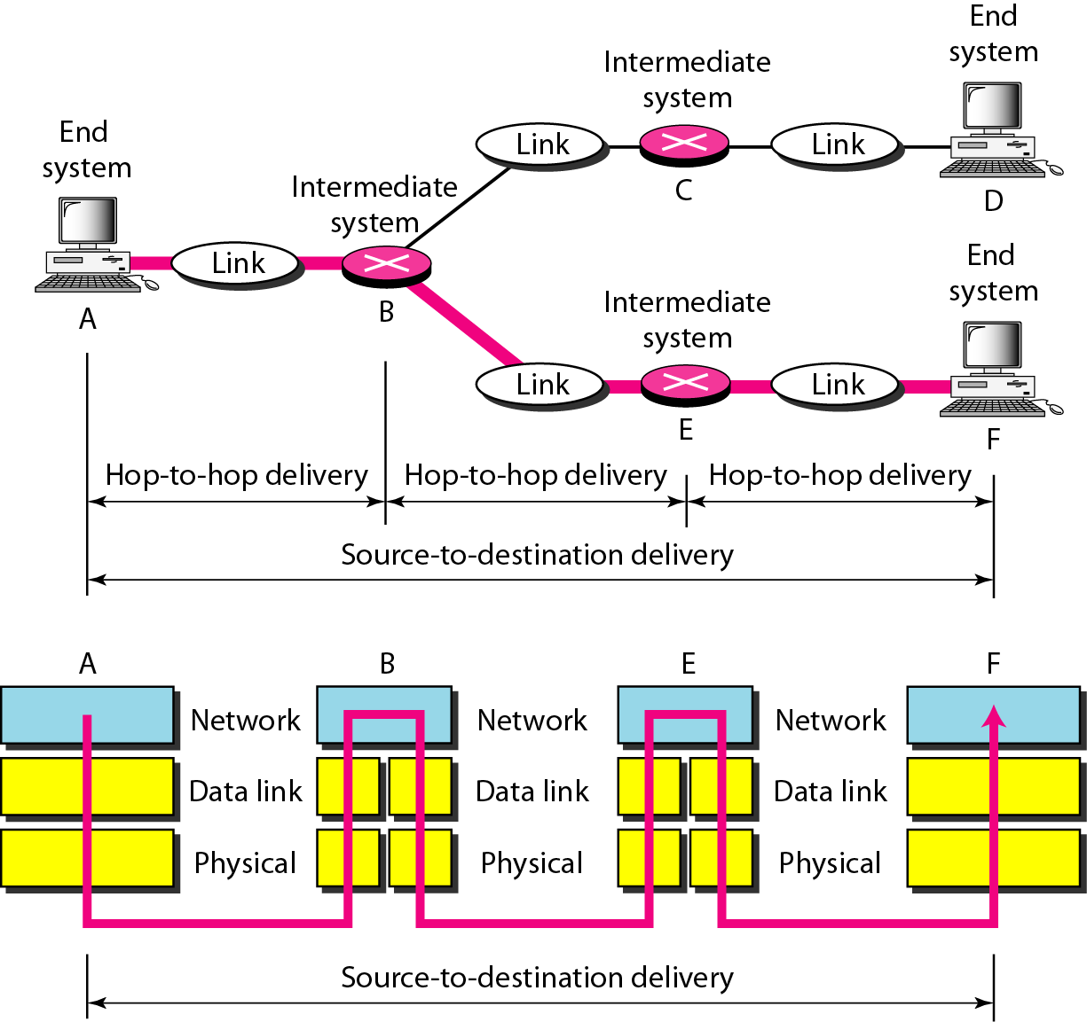
Figure Source-to-destination delivery
packets
packets

Slide 18
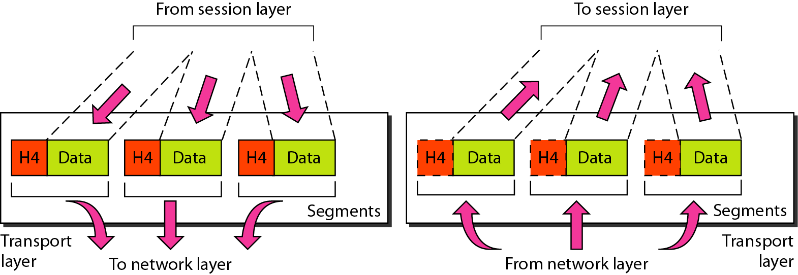
Transport Layer
End to End message delivery .
Segmentation and reassembly - The message is divided into segments and each segment is assigned a sequence number. These numbers are arranged correctly on the arrival side by this layer.
Port addressing - The header in this must therefore include a address called port address. This layer gets the entire message to the correct process on that computer.
Connection control - This can either be connectionless or connection-oriented. The connectionless treats each segment as a individual packet and delivers to the destination. The connection-oriented makes connection on the destination side before the delivery. After the delivery the termination will be terminated.
Flow and error control - Similar to data link layer, but process to process take place.

Slide 19
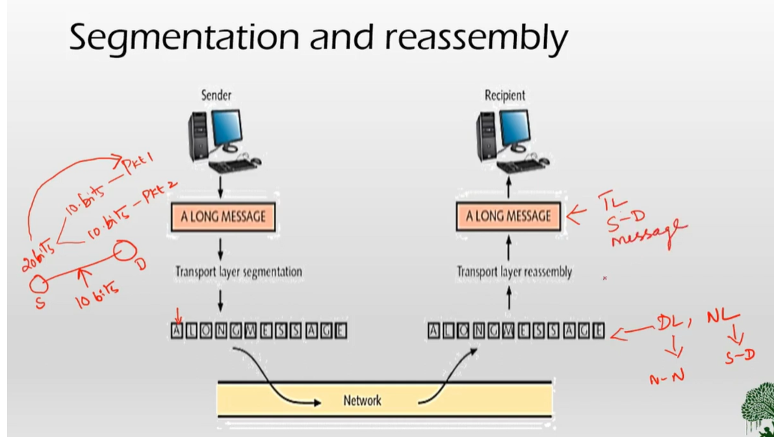

Slide 20
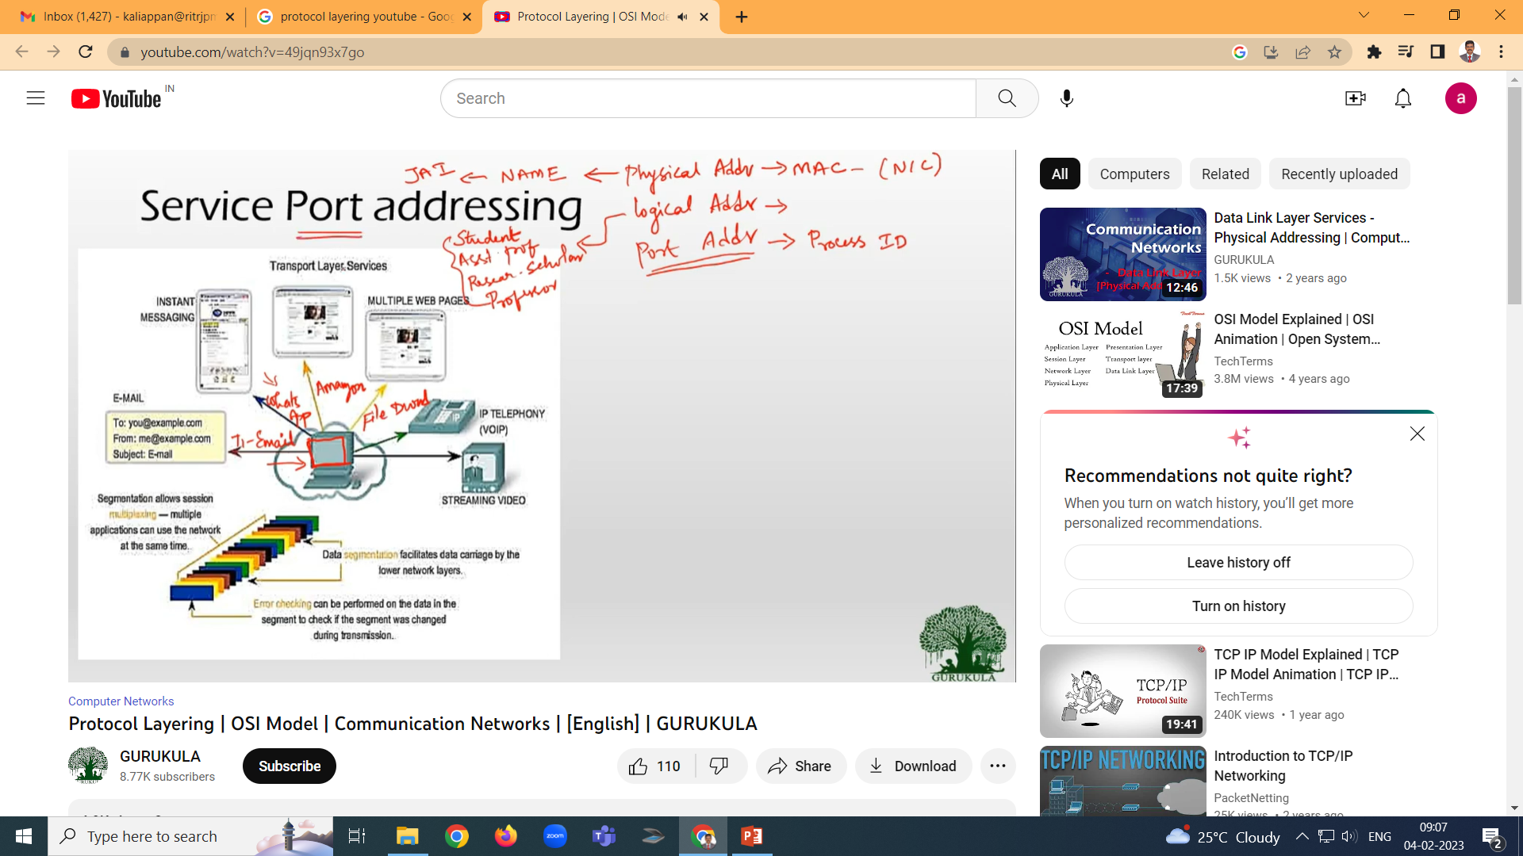
Reliable process-to-process delivery of a message
process
process

Slide 21
Note
The transport layer is responsible for the delivery of a message from one process to another.

Slide 22
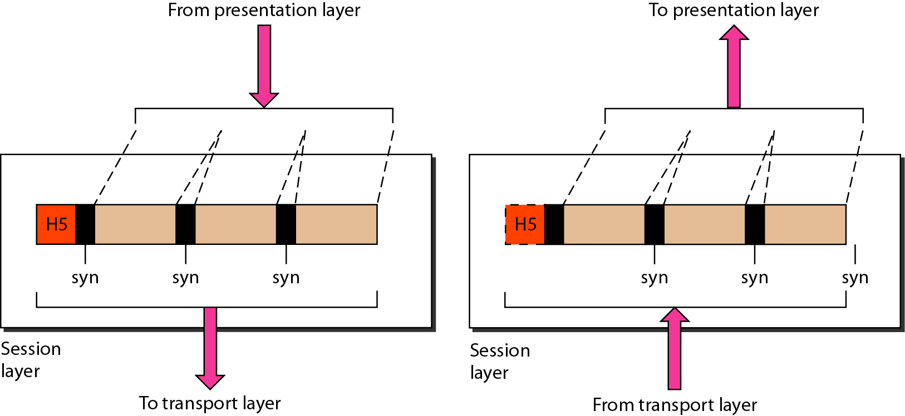
Sessions Layer
This layer establishes, session, manages and terminates connections between applications.
Dialog control - This session allows two systems to enter into a dialog either in half duplex or full duplex.
Synchronization-This allows to add checkpoints into a stream of data.

Slide 23
Note
The session layer is responsible for dialog control and synchronization.

Slide 24
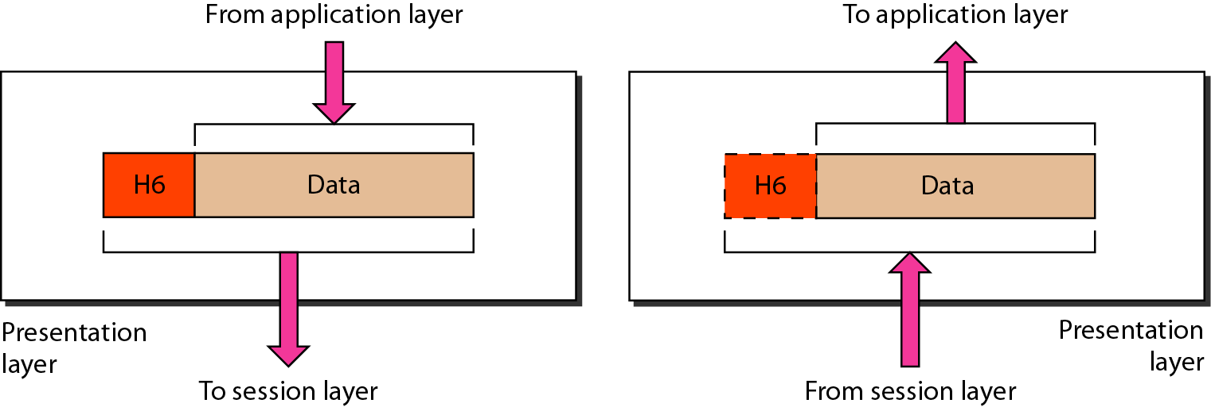
Presentation Layer
It is concerned with the syntax and semantics of information exchanged between two systems.
Translation – Different computers use different encoding system, this layer is responsible for interoperability between these different encoding methods. It will change the message into some common format.
Encryption and decryption-It means that sender transforms the original information to another form and sends the resulting message over the n/w. and vice versa.
Compression and expansion-Compression reduces the number of bits contained in the information particularly in text, audio and video.

Slide 25
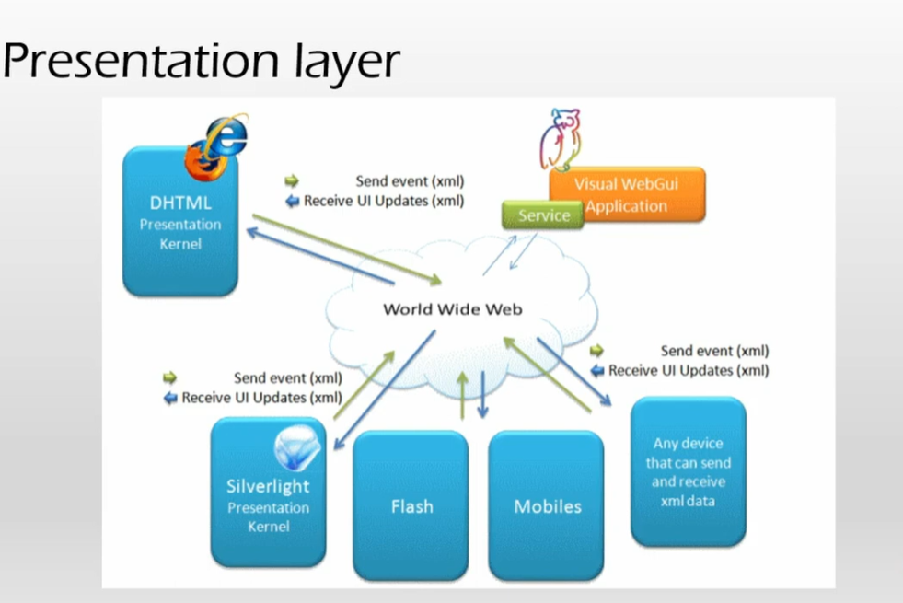
Note
The presentation layer is responsible for translation, compression, and encryption.

Slide 26
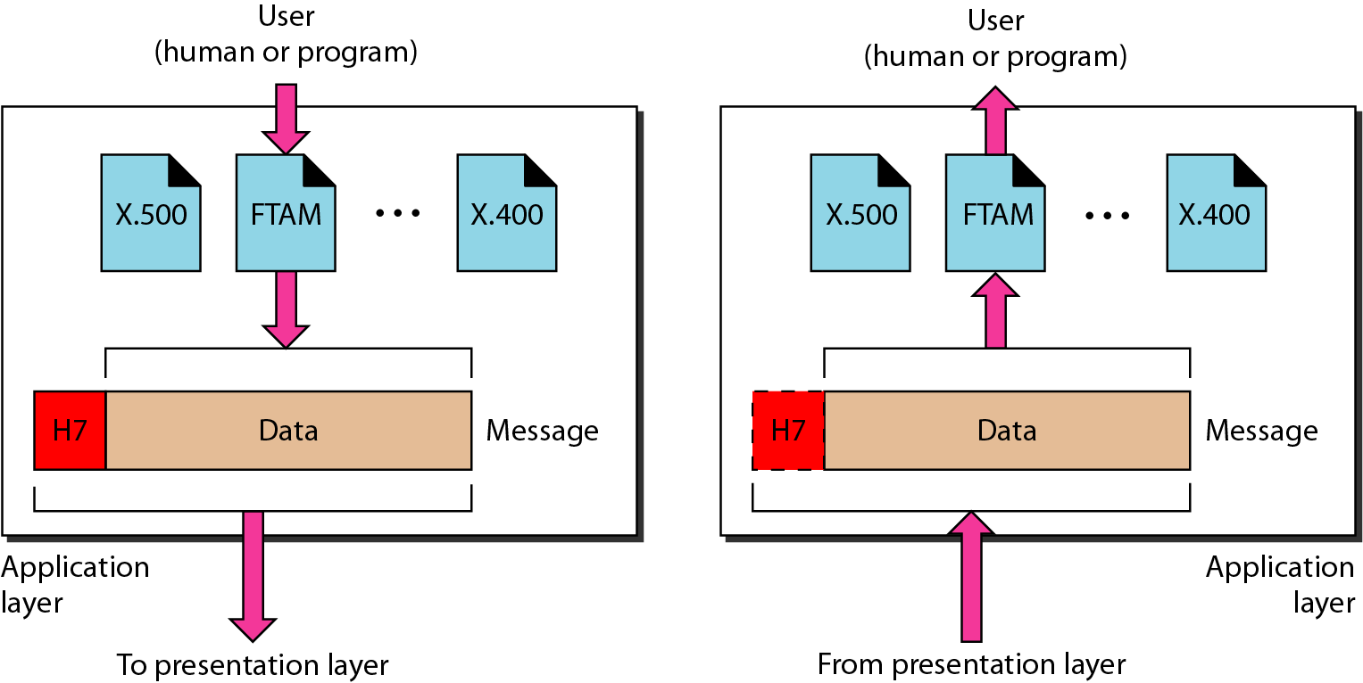
Application Layer
Enables the user, whether human or software to access the network
Provides user interfaces and support for services such as
FTAM(file transfer, access, management) - Allows user to access files in a remote host.
X.400 Mail services - Provides email forwarding and storage.
X.500 (Directory services) - Provides database sources/distributed information services to access information about various sources and objects.

Slide 27

Figure Ex: Application layer
Note
The application layer is responsible for providing services to the user.

Slide 28
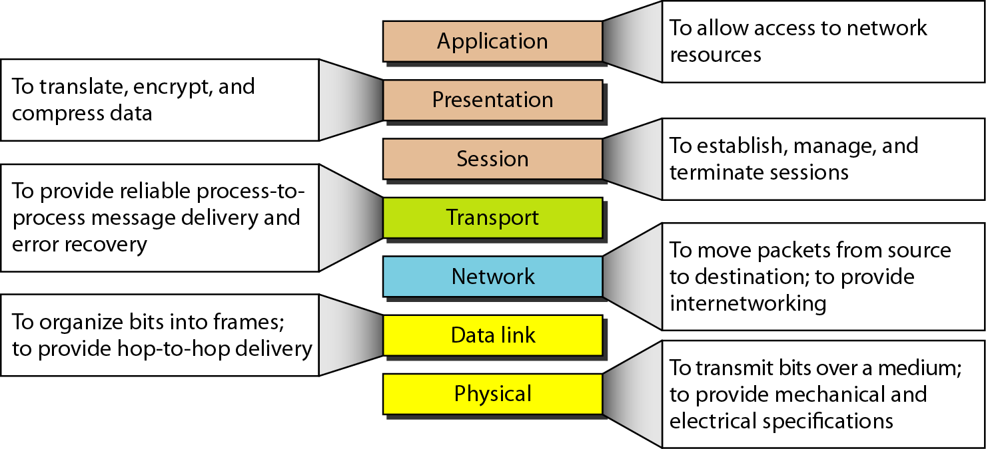
Figure Summary of layers

Slide 29
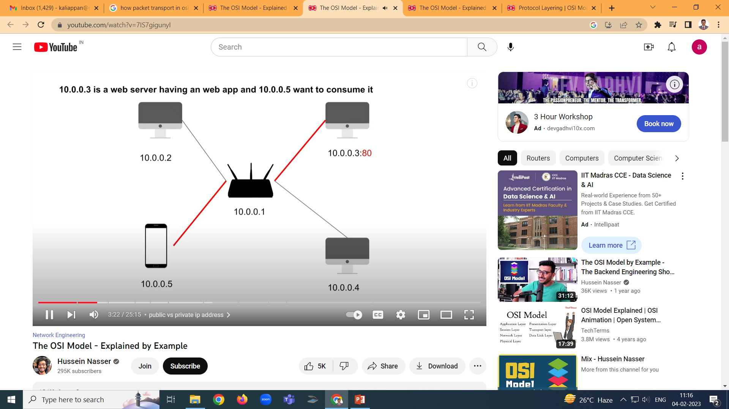
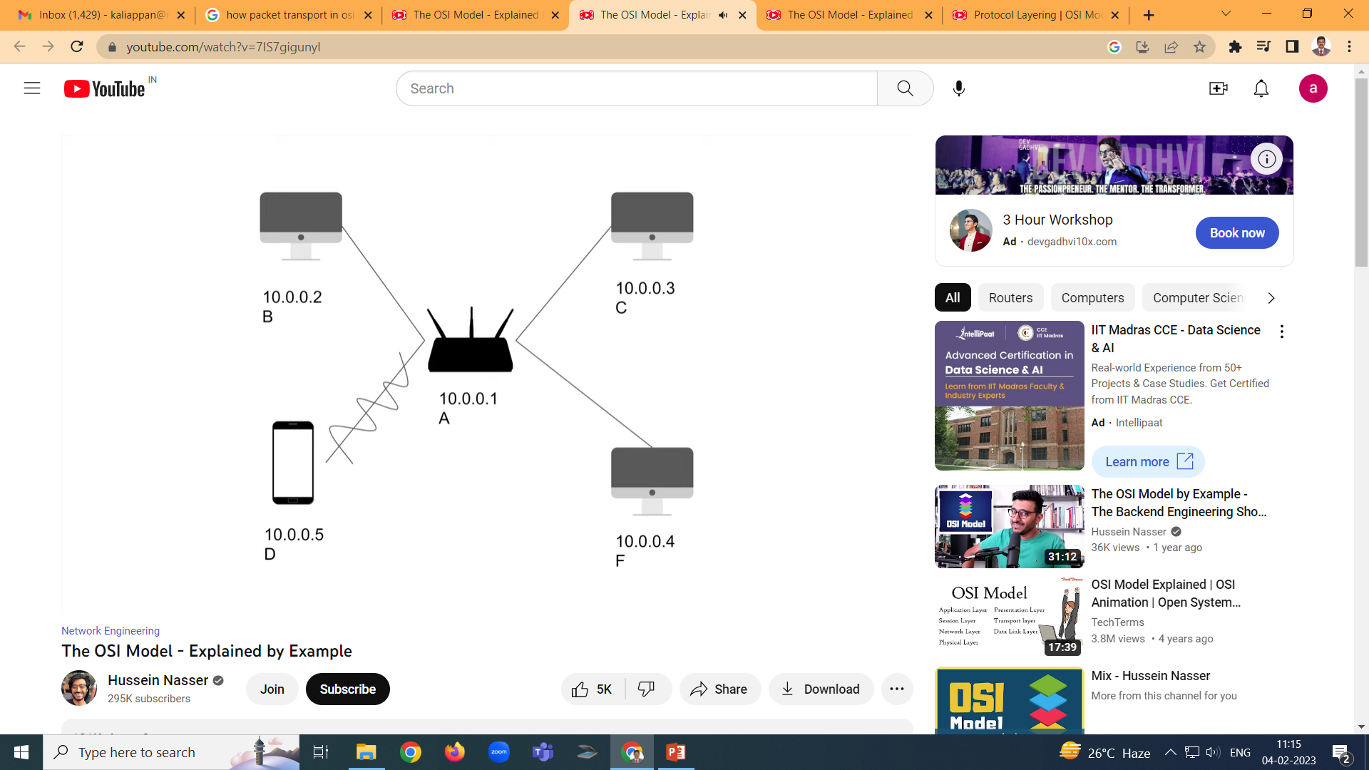
:80

Slide 30
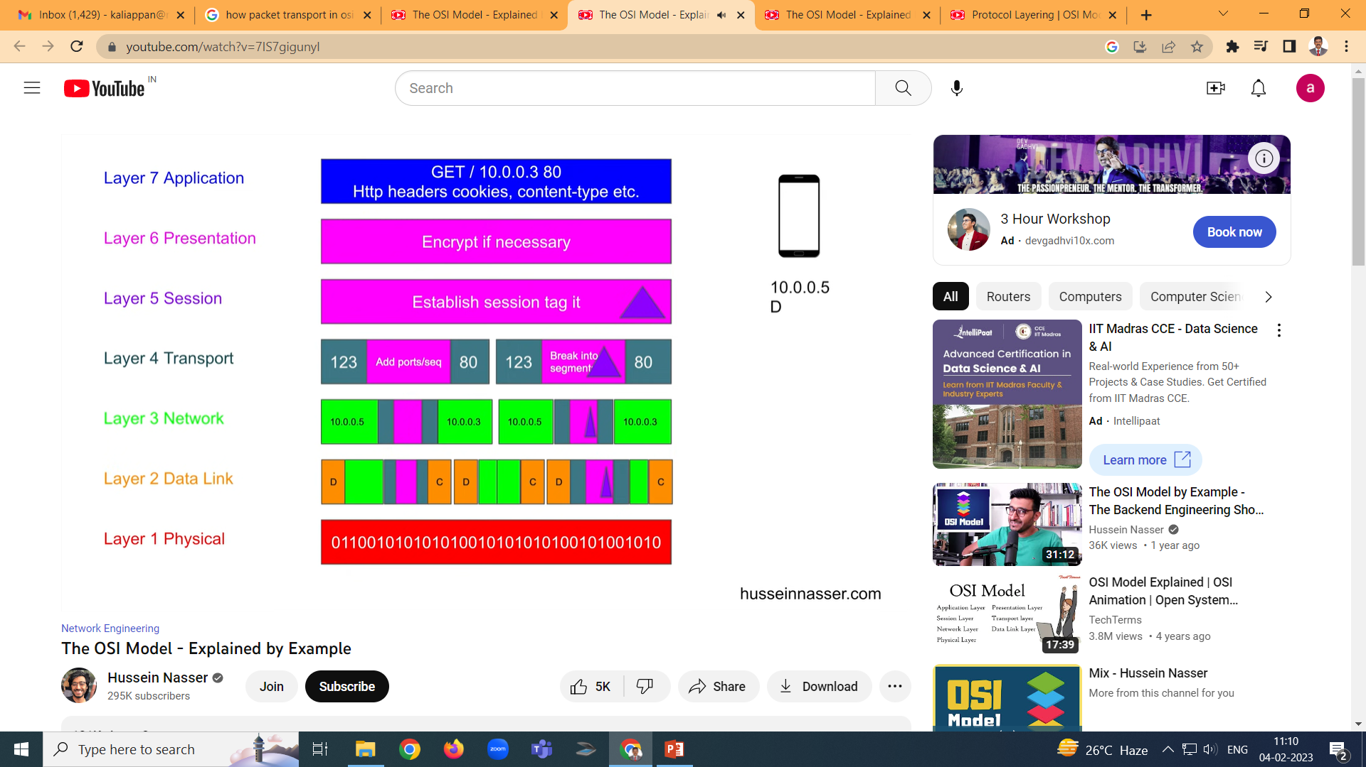

Slide 37
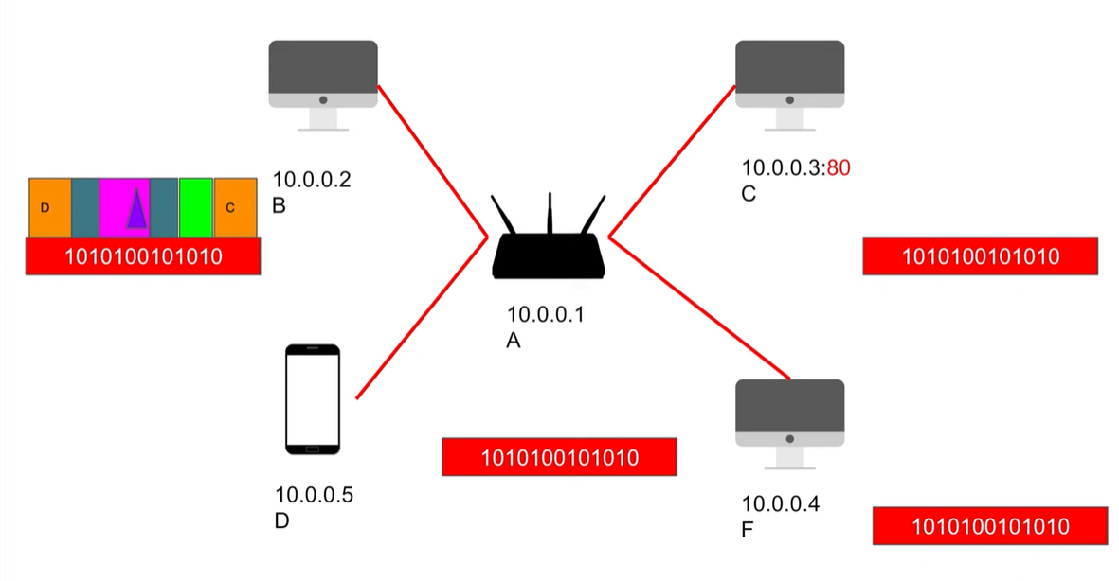

Slide 38
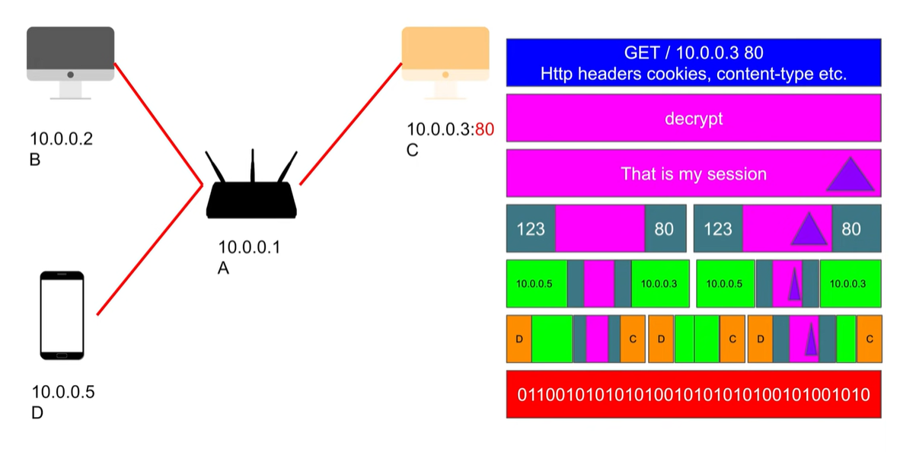

Slide 39
TCP/IP Model
TCP/IP MODEL

Slide 40
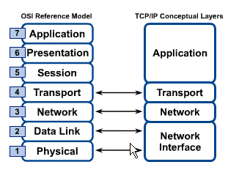
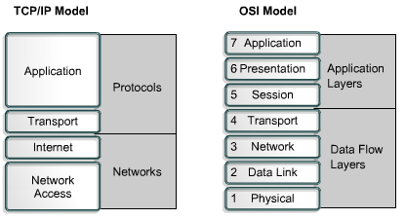
OSI & TCP/IP Models
TCP/IP Model

Slide 41
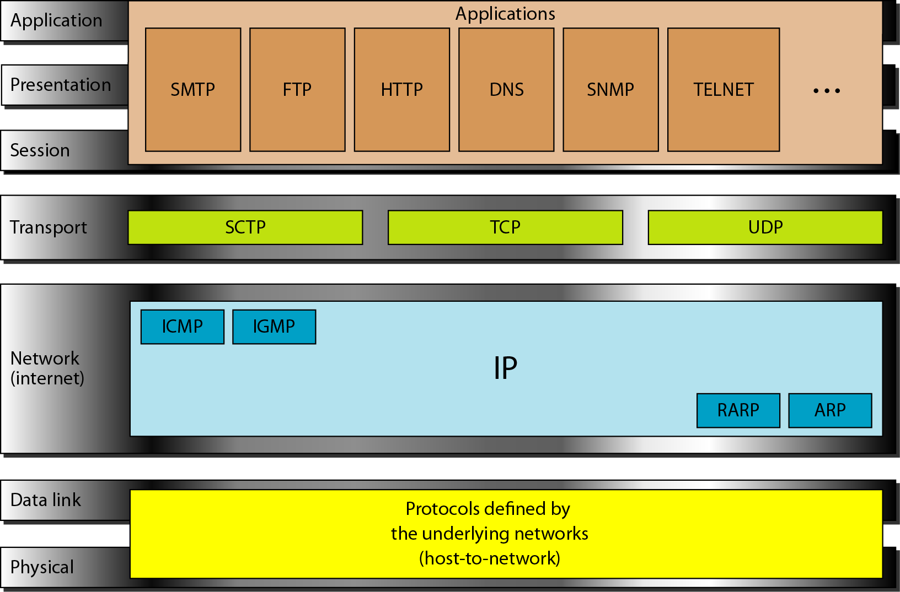
TCP/IP and OSI model

Slide 42
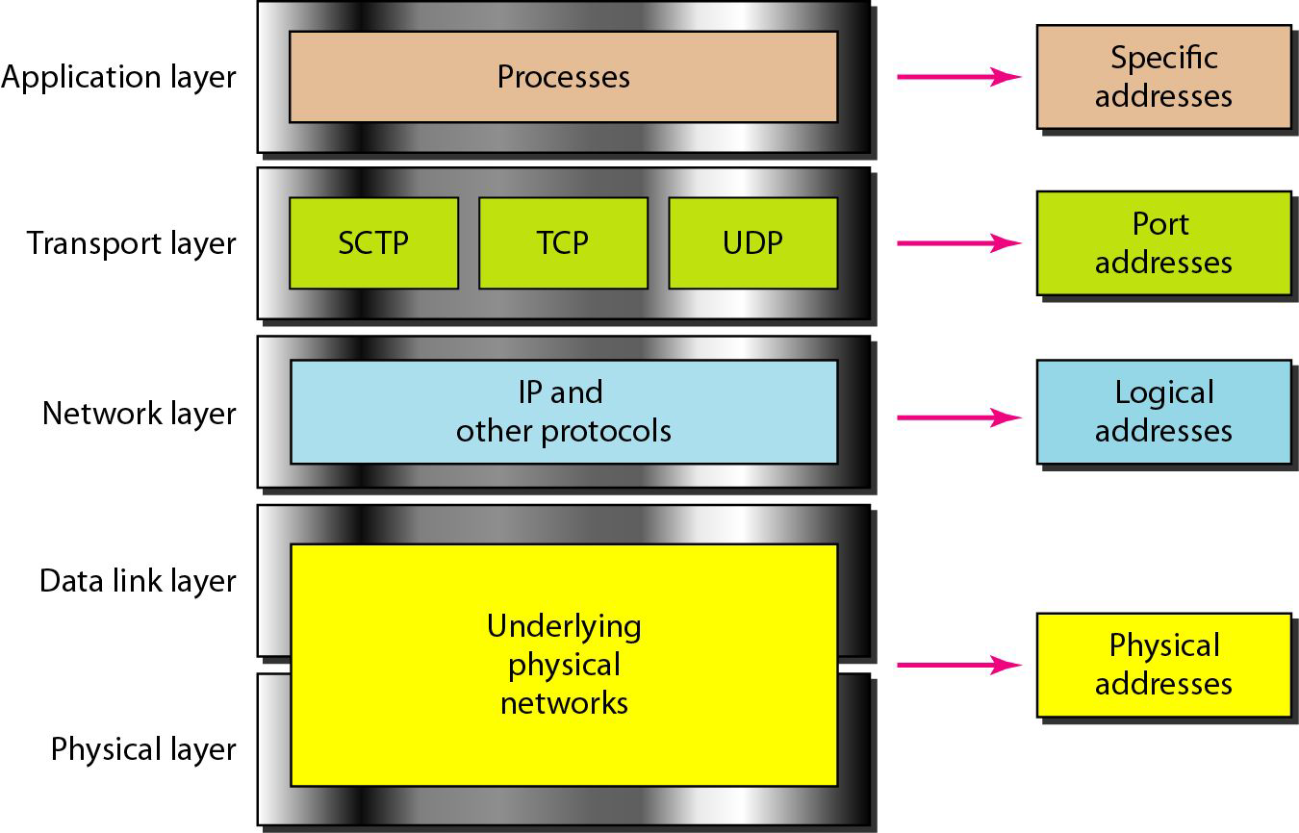
Relationship of addresses to layers

